Slide 1
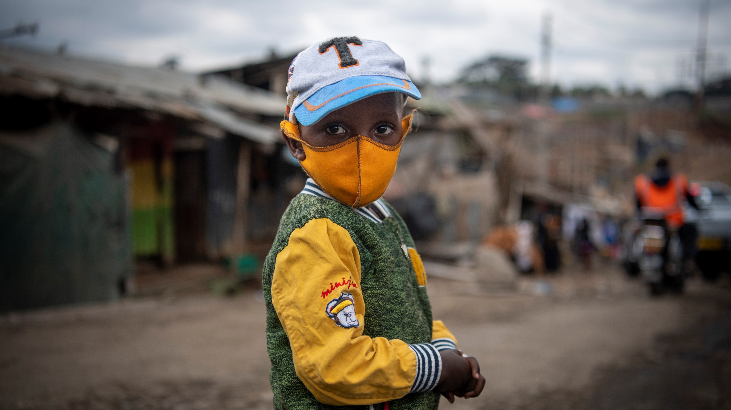

Community Rapid Assessment on COVID-19: Early Findings on Behavioral Drivers, Community Coping Mechanisms and Communication Channels in Uganda
HQ: Evaluation Office & C4D Division, ESARO: Evaluation & C4D sections, Uganda Country Office November 2020
© UNICEF/PHOTO CREDIT

Slide 2
Outline:
Community Rapid Assessment on COVID-19
Concept
Study Framework
ESAR Participating Countries and Disease Context
Methodology
Analytical Approaches
Main Questions
Early Findings
Demographics
Country Program Implications
Early Lessons Learned
Strengths and Limitations
2 | Community Rapid Assessment on COVID-19: Uganda

Slide 3
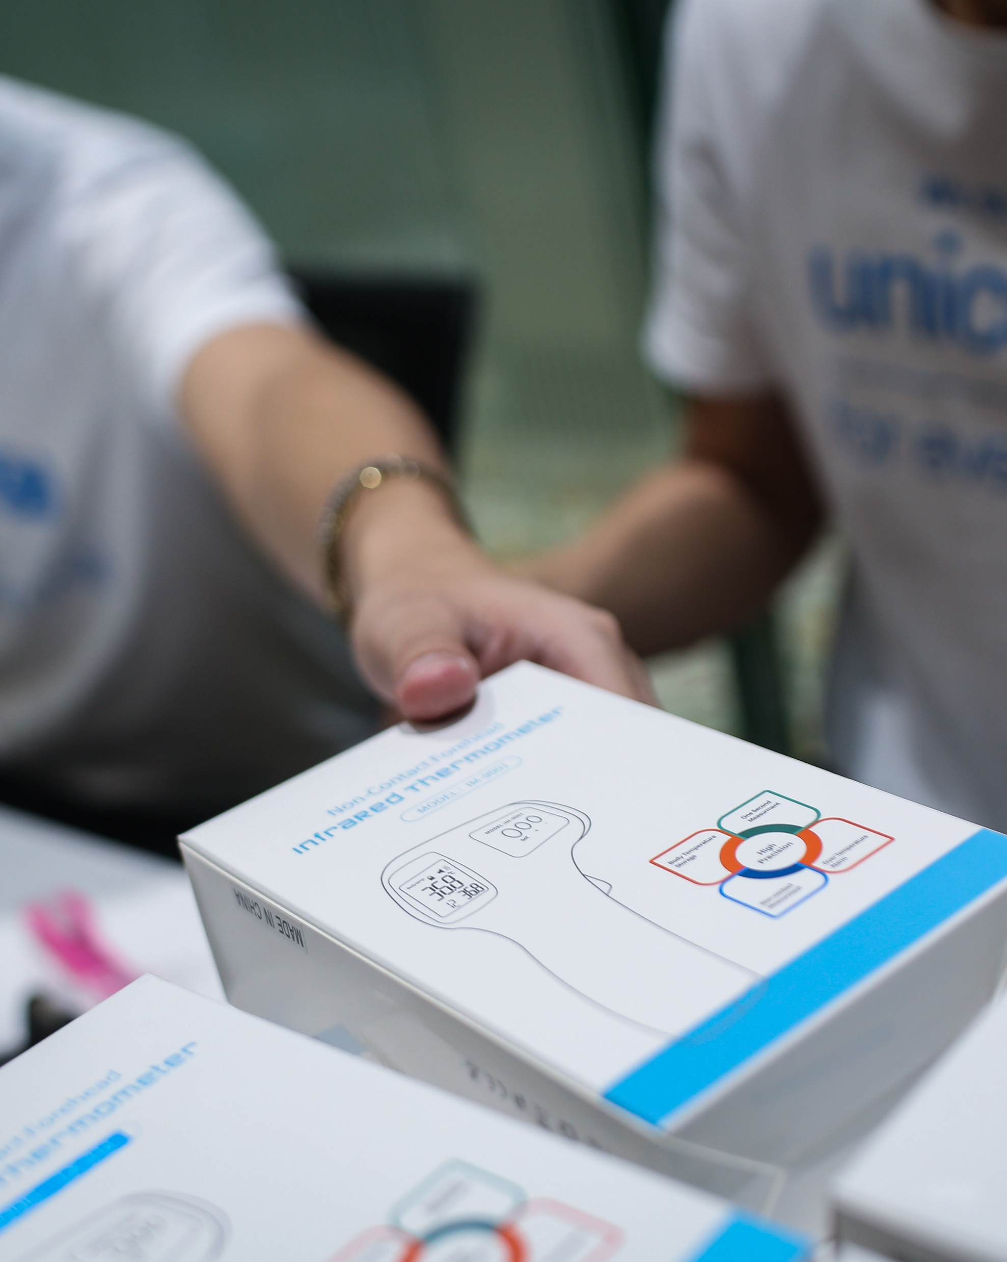
1. PROOF OF CONCEPT
A Rapid mobile-based population short survey on behavior, coping strategies and communication channels during COVID-19.
To examine behaviors and drivers using mobile phone-based population surveys in a time series in order to assess relevance and to better prepare UNICEF to address future pandemics.
To demonstrate a lightweight methodological approach that can be used in other sectors with a relatively small budget envelope.
To routinely use social and behavioral population surveys as part of a data source in understanding the organizations effectiveness, relevance, etc., in evaluation designs.
© UNICEF/PHOTO CREDIT
Find Concept Note here
3 | Community Rapid Assessment on COVID-19: Uganda

Slide 4
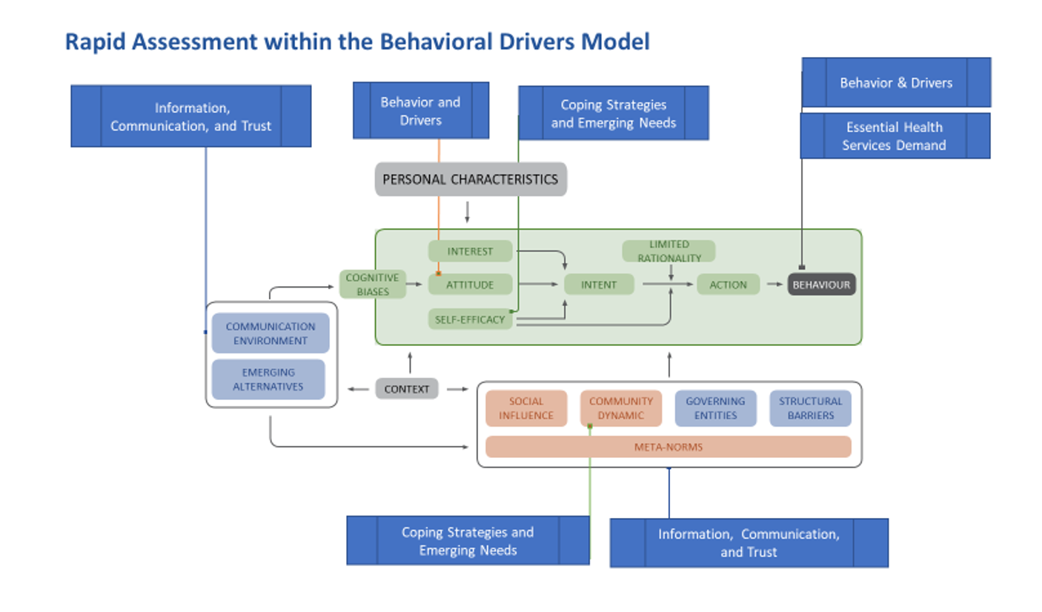
2. STUDY FRAMEWORK
To use population mobile-phone based surveying methods to examine behavioral changes, coping strategies, and evolving needs during the COVID-19 pandemic to inform programming and public policy efforts.
Find BDM framework here
4 | Community Rapid Assessment on COVID-19: Uganda
Notes:
On the CRA approach, you can add that it has been flexible in ESAR with trying to accommodate countries specific questions in questionnaire and also it integrated with existing KAp sudies in Madagascar and South Sudan

Slide 5
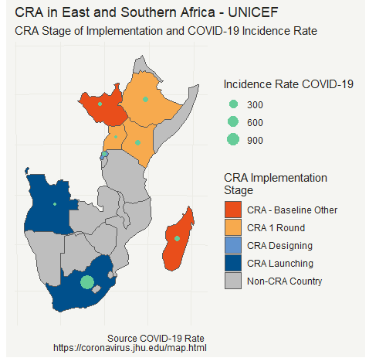
3. ESAR Participating Countries and ​
Disease Landscape
Current Participating Countries:
ANGOLA: Contracting in process
ETHIOPIA: Baseline Round 1 data collection completed; Analysis in process
KENYA: Baseline Round 1 completed & analyzed
MADAGASCAR: Baseline Round 1 completed and analyzed
RWANDA: Contracted completing, awaiting IRB approval
SOUTH AFRICA: Contracting in process
SOUTH SUDAN: Baseline Round 1 completed and analyzed
UGANDA: Baseline Round 1 completed & analyzed
5 | Community Rapid Assessment on COVID-19: Uganda
Notes:
https://covid19.who.int/table
https://africacdc.org/covid-19/

Slide 6

4. METHODOLOGY
Data Collection Modalities
Data Type: Quantitative, repeated cross-sectional time series.
Periodicity: Multiple rounds planned for 1-2 month
Geographic Coverage: National and sub-national
Sampling & Sample Size: Probabilistic; ~N= +1,000
Instrument: Short quantitative survey with standardized questions with room for country adaptation (Max 24 questions)
Demographic variables:
a) Sex* (Language in 1st Round),
b) Age,
c) Education, and
d) Urban/Rural Setting
Random Digital Dialing using Interactive Voice Recording Survey
Face to Face
Quality Control
Pre-survey testing
Methodological review of instruments
Ex-Post facto sample weighting**
Country-Level Summary
Country | Survey Size | Modality | CRA Type
Uganda | n = 2405 | IVR | 3 IVR Rounds
6 | Community Rapid Assessment on COVID-19: Uganda
Find CRA ESARO Model questionnaire here

Slide 7
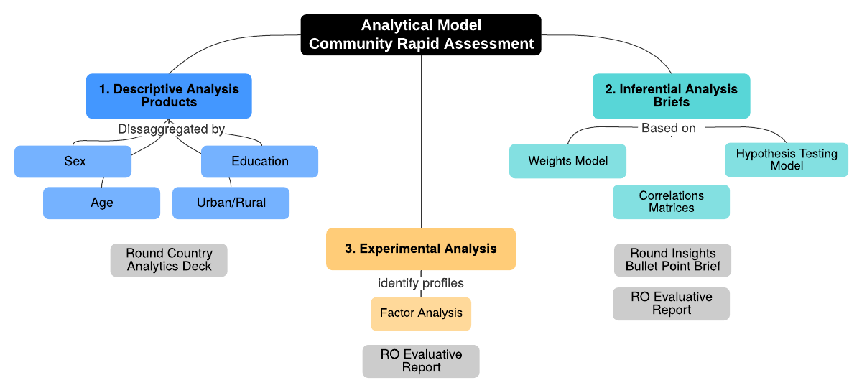
5. ANALYTICAL APPROACH
Principles:
Rapid deployment
Key insights focus on behaviors and drivers
Rigorous but flexible approach (including exploratory and non-parametric approaches)
For this review, we will:
Focus on key variables and look at comparisons across countries and groups
Highlight insights for program application
Find CRA Analytic Plan here
7 | Community Rapid Assessment on COVID-19: Uganda

Slide 8
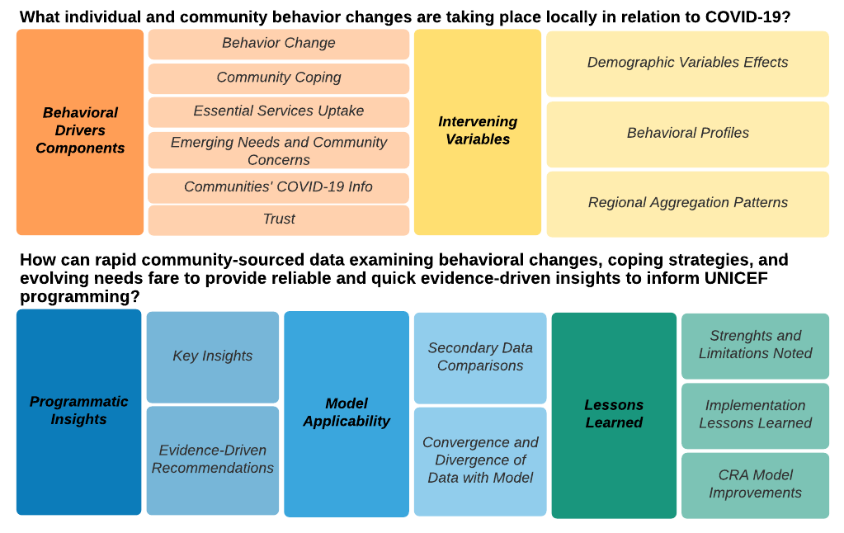
6. MAIN QUESTIONS
For these early results, we will:
Review selected key findings
Compare across countries, where possible
Highlight insights and areas for further analyses
8 | Community Rapid Assessment on COVID-19: Uganda

Slide 9
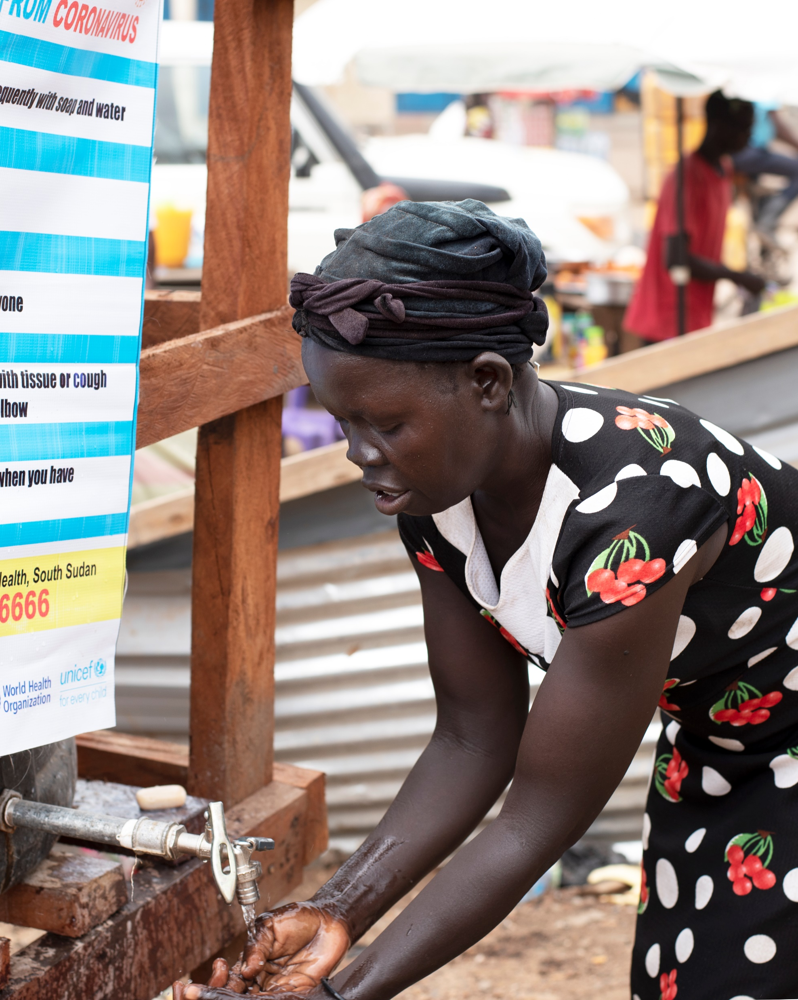
7. EARLY FINDINGS:
What are the current behavioral practices taking place in relation to COVID-19?
© UNICEF/PHOTO CREDIT
9 | Community Rapid Assessment on COVID-19: Uganda

Slide 10
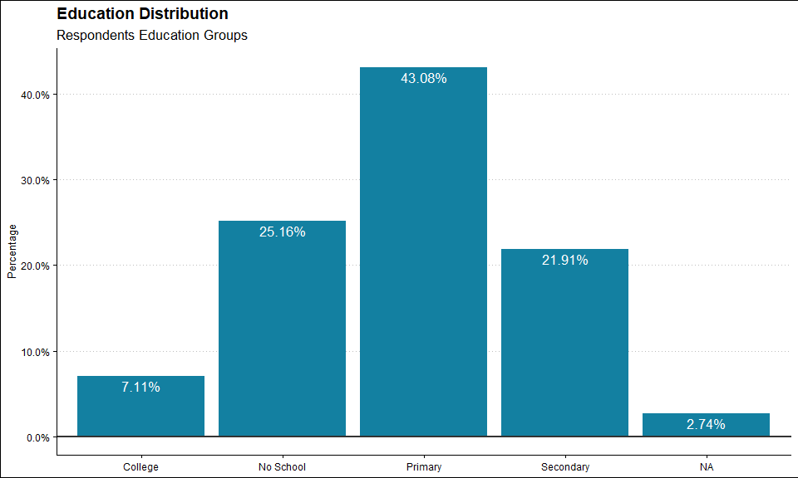
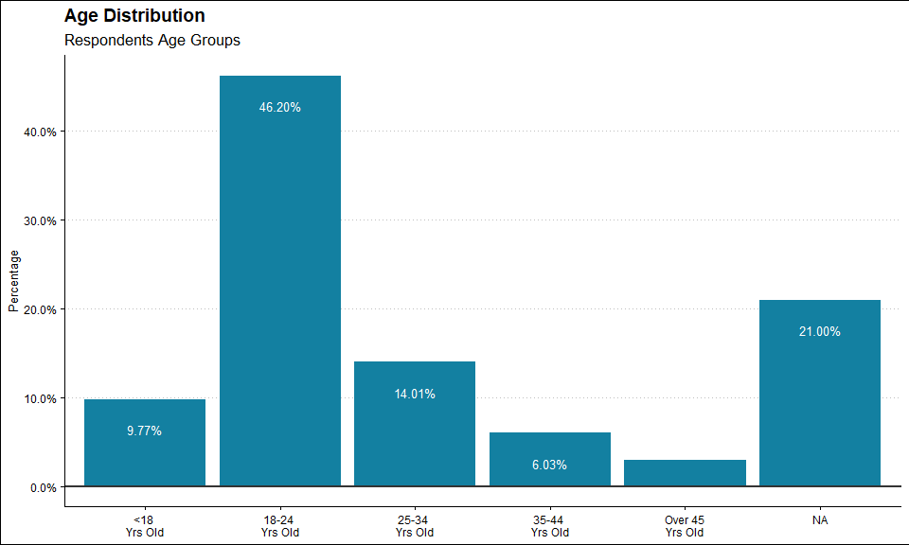
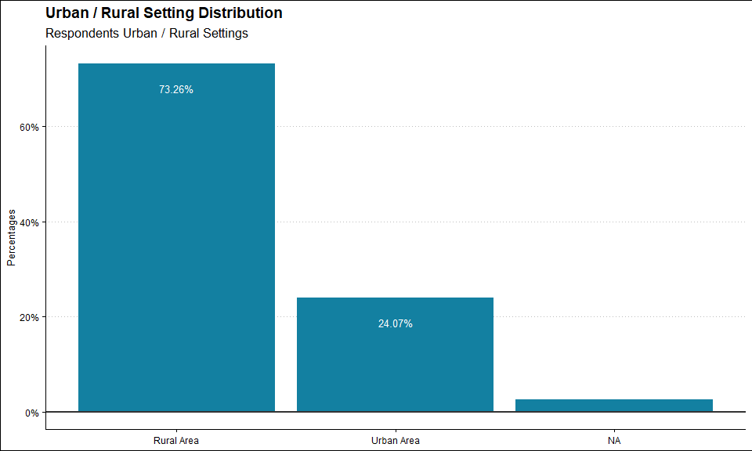
8. DEMOGRAPHICS
10 | Community Rapid Assessment on COVID-19: Uganda
Notes:
- Across all countries we can see some distributions that will be controlled for on post stratification, including gender gap on respondents.
- However, we also can see that in comparison female and male distributions are constant when compared on rural and urban, pointing that gender gap appears also randomly, which can be solved through weighting.
- Similarly, the age trends points toward younger respondents which is expected given the relatively young population of the countries in East and Southern Africa.

Slide 11
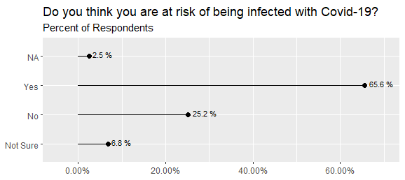
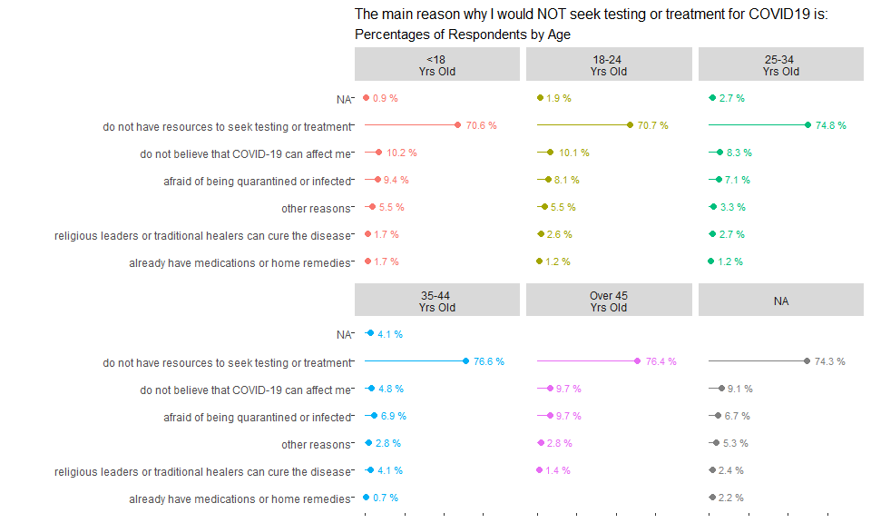
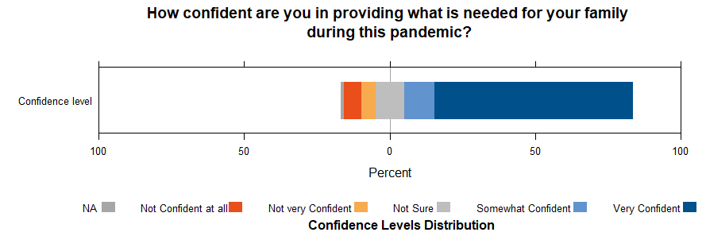
What are the risk perceptions and barriers communities have during COVID-19?
11 | Community Rapid Assessment on COVID-19: Uganda
Notes:
- Risk perception is high for majority of respondents across all countries. However, there is a visible segment that perceives to be at low risk of COVID-19.
- Looking at more detail at those that deem themselves as less risk can help target messaging and also identify if those groups correspond to vulnerable populations, for example those older than 60 years old, as has been the case in South Sudan.
- For Kenya, although risk perception was not directly asked, we can see that on the issues of most concern for families with Children, which is key for UNICEF, the biggest concern is falling sick with COVID-19. Also, specific issues regarding socio-economic impact are high on the respondent’s concerns.

Slide 12
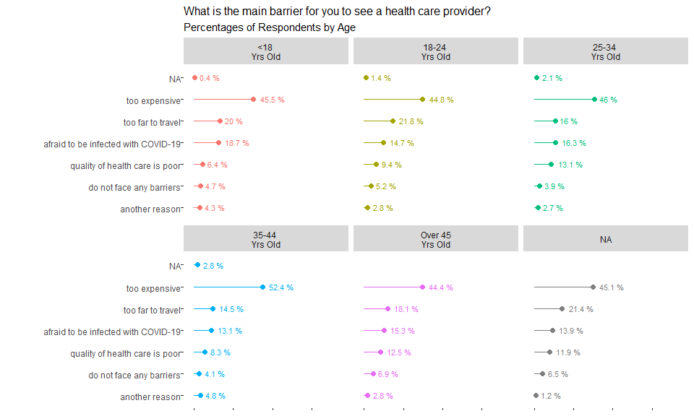
What are the risk perceptions and barriers communities have during COVID-19?
12 | Community Rapid Assessment on COVID-19: Uganda
Notes:
- Risk perception is high for majority of respondents across all countries. However, there is a visible segment that perceives to be at low risk of COVID-19.
- Looking at more detail at those that deem themselves as less risk can help target messaging and also identify if those groups correspond to vulnerable populations, for example those older than 60 years old, as has been the case in South Sudan.
- For Kenya, although risk perception was not directly asked, we can see that on the issues of most concern for families with Children, which is key for UNICEF, the biggest concern is falling sick with COVID-19. Also, specific issues regarding socio-economic impact are high on the respondent’s concerns.

Slide 13
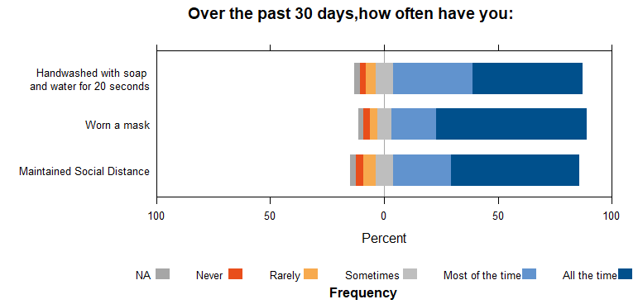
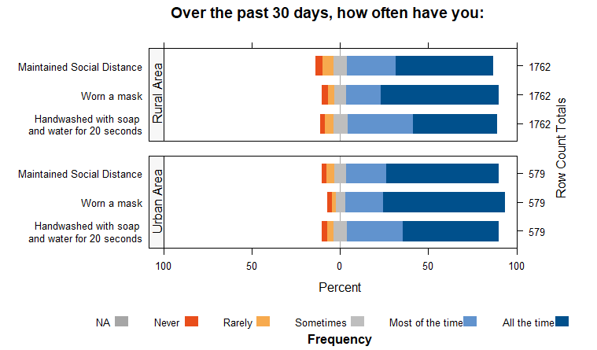
What are communities doing to protect themselves from COVID-19?
Notes:
when contrasted with questions on how the respondents see community compliance the levels are not as high, so a self reporting effect is present that can also be read in relation to other dimensions.
For example, we can see how most respondents self-report high levels of practice of protective practices which can point out that due to a high risk perception there is a latent sense of performing the protective practices. However, it is important to contrast this information with observational studies on the ground, where it has been identified that practices do not take place as self-reported.
This contradiction can help identify the right messaging to send, as respondents self-reporting shows the awareness of the practice, or at least reporting that such practice takes place. Messaging is likely to benefit more on identifying better ways to incentivize compliance rather than knowledge, as the knowledge of the practice per se show to be widely present through such awareness.
This also helps identify that intention to perform the practices is present as the perception of risk combined with self-reporting of compliance can help identify that behaviorally at least the intention to comply, is present.

Slide 14
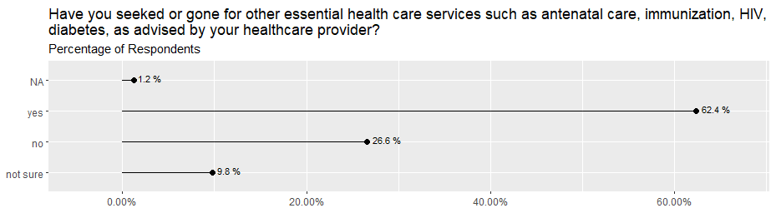
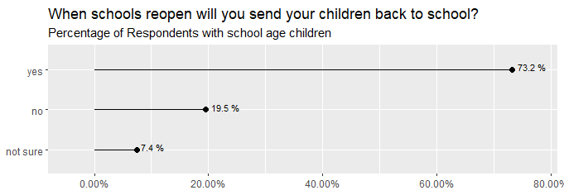
How communities see access to essential services during COVID-19?
14 | Community Rapid Assessment on COVID-19: Uganda
Notes:
When we see another area for key services, Health care, we see that despite the pandemic a significant portion of the population are still attending health care services. This is important because it highlights how despite a perception of risk population still rely on an essential service like this.
This should be weighted and compared to previous levels of access to services to see if any significant change has taken place and if so whether or not this impacts particular groups. For example, it would be important to identify in Kenya, after a deeper dive on the data to better look at the profile of Urban Males as they seem to report less seeking health care services.

Slide 15
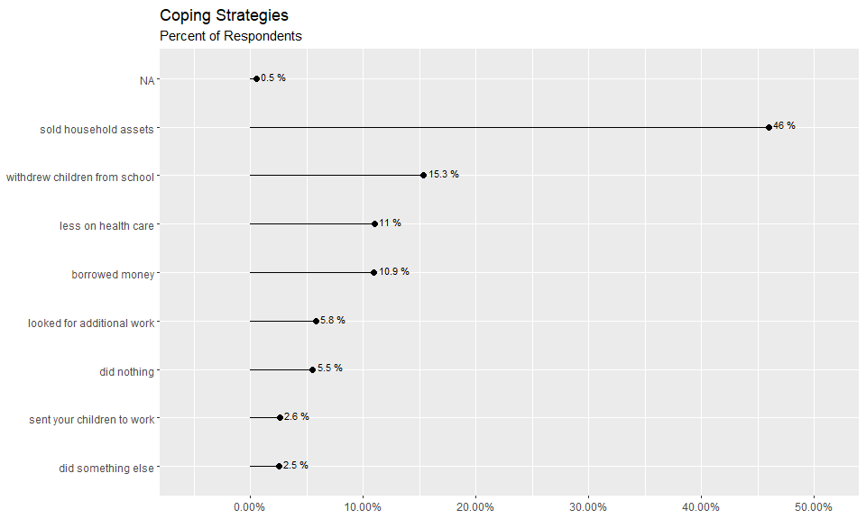
What are the emerging needs and concerns of the community?
15 | Community Rapid Assessment on COVID-19: Uganda
Notes:
Furthermore, when seeing the impact at the community level, we can start identifying some areas where respondents are reporting changes. For example, respondents in Madagascar have identified rather large percentages of changes on food consumption and basic needs products.
More worrisome if the reported reduction of vaccinations and breastfeeding, where if contrasted with other information, can likely point to very sensitive areas where even such smaller percentages can have a great impact for populations at risk and the development of children.
We can also see that this seems to impact the overall confidence of the respondents to provide for their families. Although there are large levels of confidence, the levels of uncertainty see to change for key age groups in Kenya, where groups between 25-34 years old have greater number of respondents unsure. A later test of correlation of this groups and access to services and whether they have children or not, is likely to shed light on possible impacts for such groups.

Slide 16
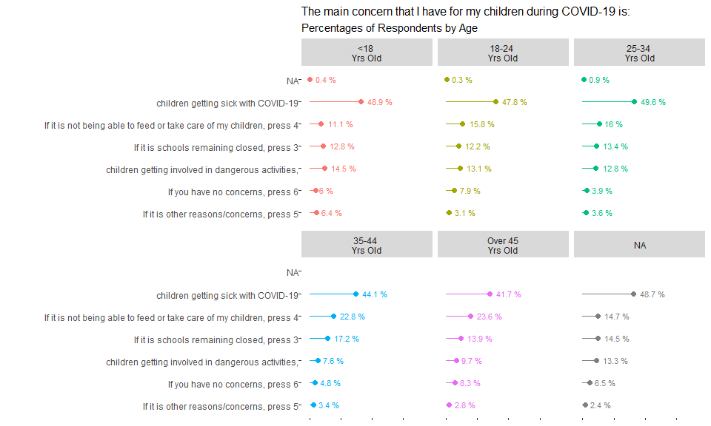
What are the emerging needs and concerns of the community?
16 | Community Rapid Assessment on COVID-19: Uganda
Notes:
Furthermore, when seeing the impact at the community level, we can start identifying some areas where respondents are reporting changes. For example, respondents in Madagascar have identified rather large percentages of changes on food consumption and basic needs products.
More worrisome if the reported reduction of vaccinations and breastfeeding, where if contrasted with other information, can likely point to very sensitive areas where even such smaller percentages can have a great impact for populations at risk and the development of children.
We can also see that this seems to impact the overall confidence of the respondents to provide for their families. Although there are large levels of confidence, the levels of uncertainty see to change for key age groups in Kenya, where groups between 25-34 years old have greater number of respondents unsure. A later test of correlation of this groups and access to services and whether they have children or not, is likely to shed light on possible impacts for such groups.

Slide 17
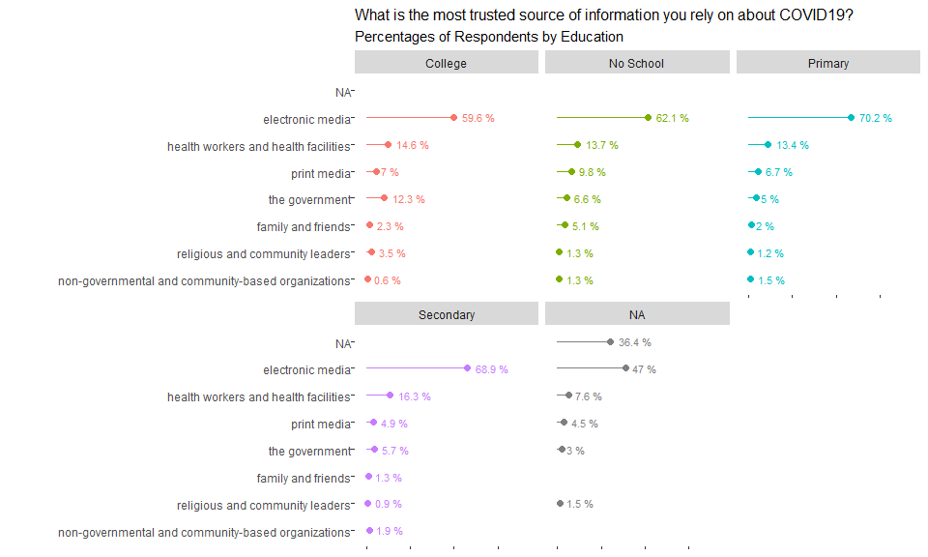
How are communities receiving their COVID-19 information?
17 | Community Rapid Assessment on COVID-19: Uganda
Notes:
We can also review the importance of identifying best channels to communicate to particular groups and settings, and overall assess the adequacy of current messaging. For example we can identify that in South Sudan community presence communication channels have been more effective to relay COVID-19 than radio TV and Newspapers, and that for example Family and friends is the third highest channel for females. For Madagascar, there seems to be significant differences on the role of TV and Radio stations between Urban and Rural.
This questions was not included in Kenya.

Slide 18
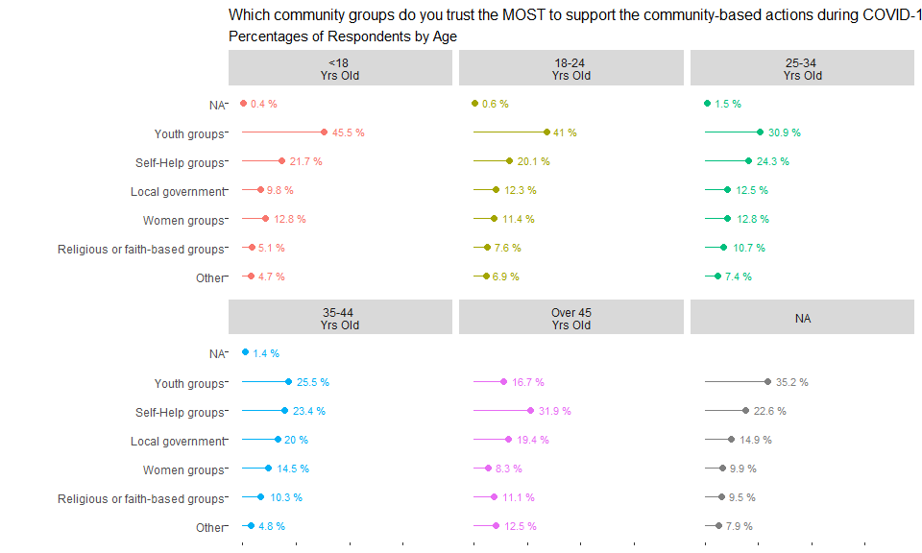
How are communities receiving their COVID-19 information?
18 | Community Rapid Assessment on COVID-19: Uganda
Notes:
We can also review the importance of identifying best channels to communicate to particular groups and settings, and overall assess the adequacy of current messaging. For example we can identify that in South Sudan community presence communication channels have been more effective to relay COVID-19 than radio TV and Newspapers, and that for example Family and friends is the third highest channel for females. For Madagascar, there seems to be significant differences on the role of TV and Radio stations between Urban and Rural.
This questions was not included in Kenya.

Slide 19
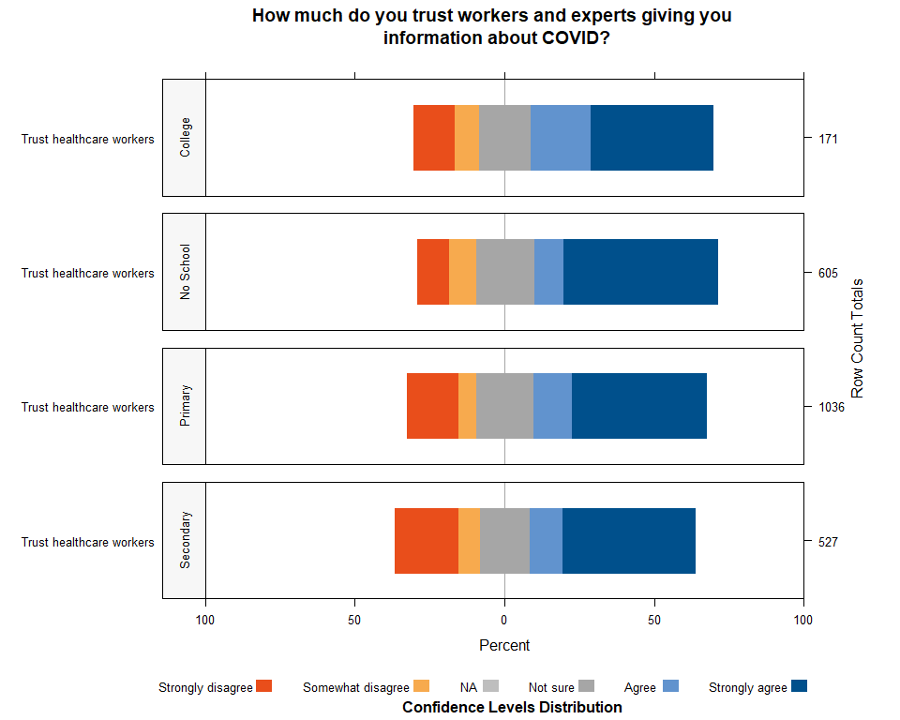
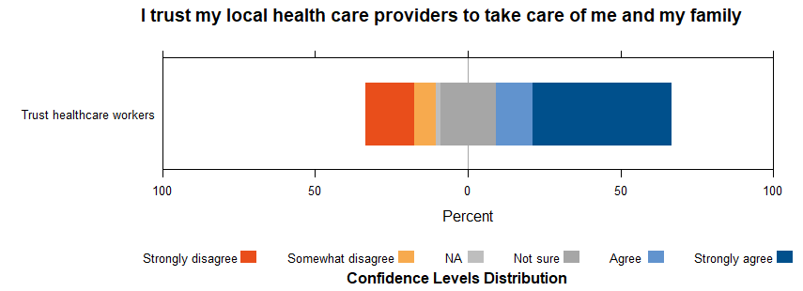
To what extent do communities trust their local health care providers during COVID-19?
19 | Community Rapid Assessment on COVID-19: Uganda
Notes:
Overall, trust play a key factor. For example, for the three countries included, although with different scales that are still narratively relatable and comparable, we can see that trust and confidence on health care providers is high for the most part.
However, in comparison with all other Likert scales on self report confidence the trust levels for lack of confidence and uncertainty are higher. This grants a further look when we will look into hypothesis testing as trust is one key factor as operationalized in the Behavioral Drivers Model when looking at how behaviors overall take place.

Slide 20
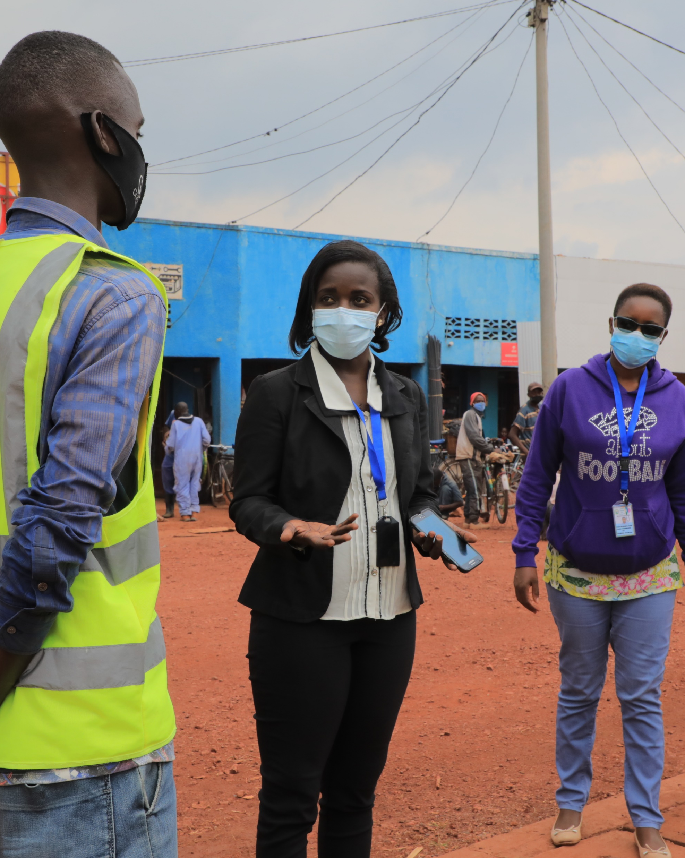
9. Findings: How can rapid community-sourced data provide reliable and quick evidence-driven insights to inform UNICEF programming?
Program Implications for Uganda
© UNICEF/PHOTO CREDIT
20 | Community Rapid Assessment on COVID-19: Uganda

Slide 21
UGANDA: Key Takeaways
Risk and barriers: There is high perception of being at risk, however between1/4 to 1/3 feel are not at risk or do not know if they are at risk. Significant barriers exists for lack of resources to access health services and to treat COVID-19.
Protective behaviors: A high percentage of respondents report complying with protective behaviors. However, this might not be actual practice although highlights awareness of the importance of the practice and need to look at barriers and complement with qualitative observations.
Access to services: A majority of the population has looked for health services. Similarly, a majority of parents will like their children to go back to school. However, about one third report to not have accessed health services which likely compounds other health problems.
Coping Mechanisms: 15 of every 100 respondents report that they have taken their children out of school to cope with the ongoing pandemic. Almost half of all respondents have sold something from home, and 1 of every 10 has reduced expenses on health care.
21 | Community Rapid Assessment on COVID-19: Uganda

Slide 22
UGANDA: Key Takeaways (continued)
Concerns: A majority of respondents worry about their children getting sick. For the rest of concerns, they change on their relevance depending of age group of the respondent.
Receiving Information: Digital Media is the most trusted source of information. However, when asked about community groups that are trusted youth and self-help groups also receive a trust response from the respondents.
Trust Health Care Workers: Overall there is high level of trust towards health workers. However, the levels of mistrust are also relatively high as the levels with more disagreement with the perception that health workers are trustworthy in some instances in greater than 1 in every 4 individuals(+25% of Strongly disagree and disagree altogether).
22 | Community Rapid Assessment on COVID-19: Uganda

Slide 23
UGANDA: Program Implications, Use and Uptake
1. How have you used, or will you use insights generated by this first round of data collection to improve current CO responses to COVID-19?
2. What is missing?
23 | Community Rapid Assessment on COVID-19: Uganda

Slide 24
UGANDA: Program Implications, Use and Uptake
2. What are some of the lessons learned about the method and questionnaire used during this first round of data collection?
3. What are the most critical population data needs for UNICEF C4D and governments to act on at this stage in the pandemic?
4. What are the critical behaviors that will need to be observed during the pandemic?
24 | Community Rapid Assessment on COVID-19: Uganda

Slide 25
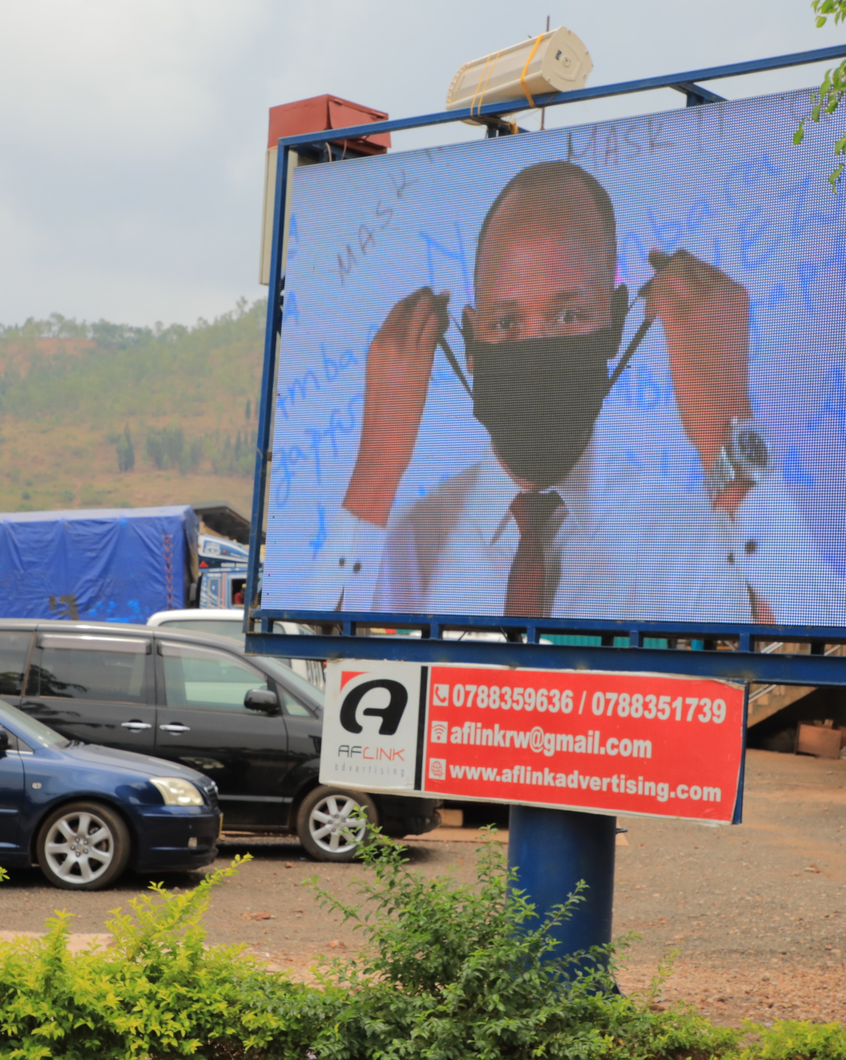
10. Early Lessons Learned
Identifying differences between demographic groups and their driving factors to enhance RCCE programming and fine-tune interventions
Difference on protective practices can help pinpoint issues on interventions and support areas to increase usage rates, including identifying issues of availability of protective gear
Identifying the trusted Community Groups and Information Channels helps strengthen community programming
Triangulating and contextualizing CRA information with qualitative data, especially field observations can give a very valuable picture of the situation
© UNICEF/PHOTO CREDIT
25 | Community Rapid Assessment on COVID-19: Uganda

Slide 26
11. Strengths and Limitations
Strengths:
Quick adaptation of survey to country needs especially in emergencies. Phones allow for quick and flexible changes in questions.
Reduced costs and time when compared to other alternatives (vs. Paper Based)
Standardization facilitates analysis and design
Sources data directly from individuals rather than head of households
Richness of cross-tabular analysis with available demographic variables (Hypothesis testing needed)
Temporal element provides richer narrative of evolving situation.
BDM strong adaptability across sectors
Short surveys in time series allows for quicker results iteration of interventions or strategies.
Limitations:
Limited demographic insights due to absence of gender variable
Survey length using phones limits extent of investigation.
Variable airtime costs and phone penetration rates may skew representativeness of population.
Limited aggregation and comparability at regional level due to heterogeneity of surveys
Absence of comparable studies
Generalized difficulty to integrate different surveys to contrast results
Observational effect on self-reporting questions on ‘practices’ (Desirability Bias)
Demand for adequate analytical capacity across the organization if such high frequency systems are in place.
26 | Community Rapid Assessment on COVID-19: Uganda

Slide 27
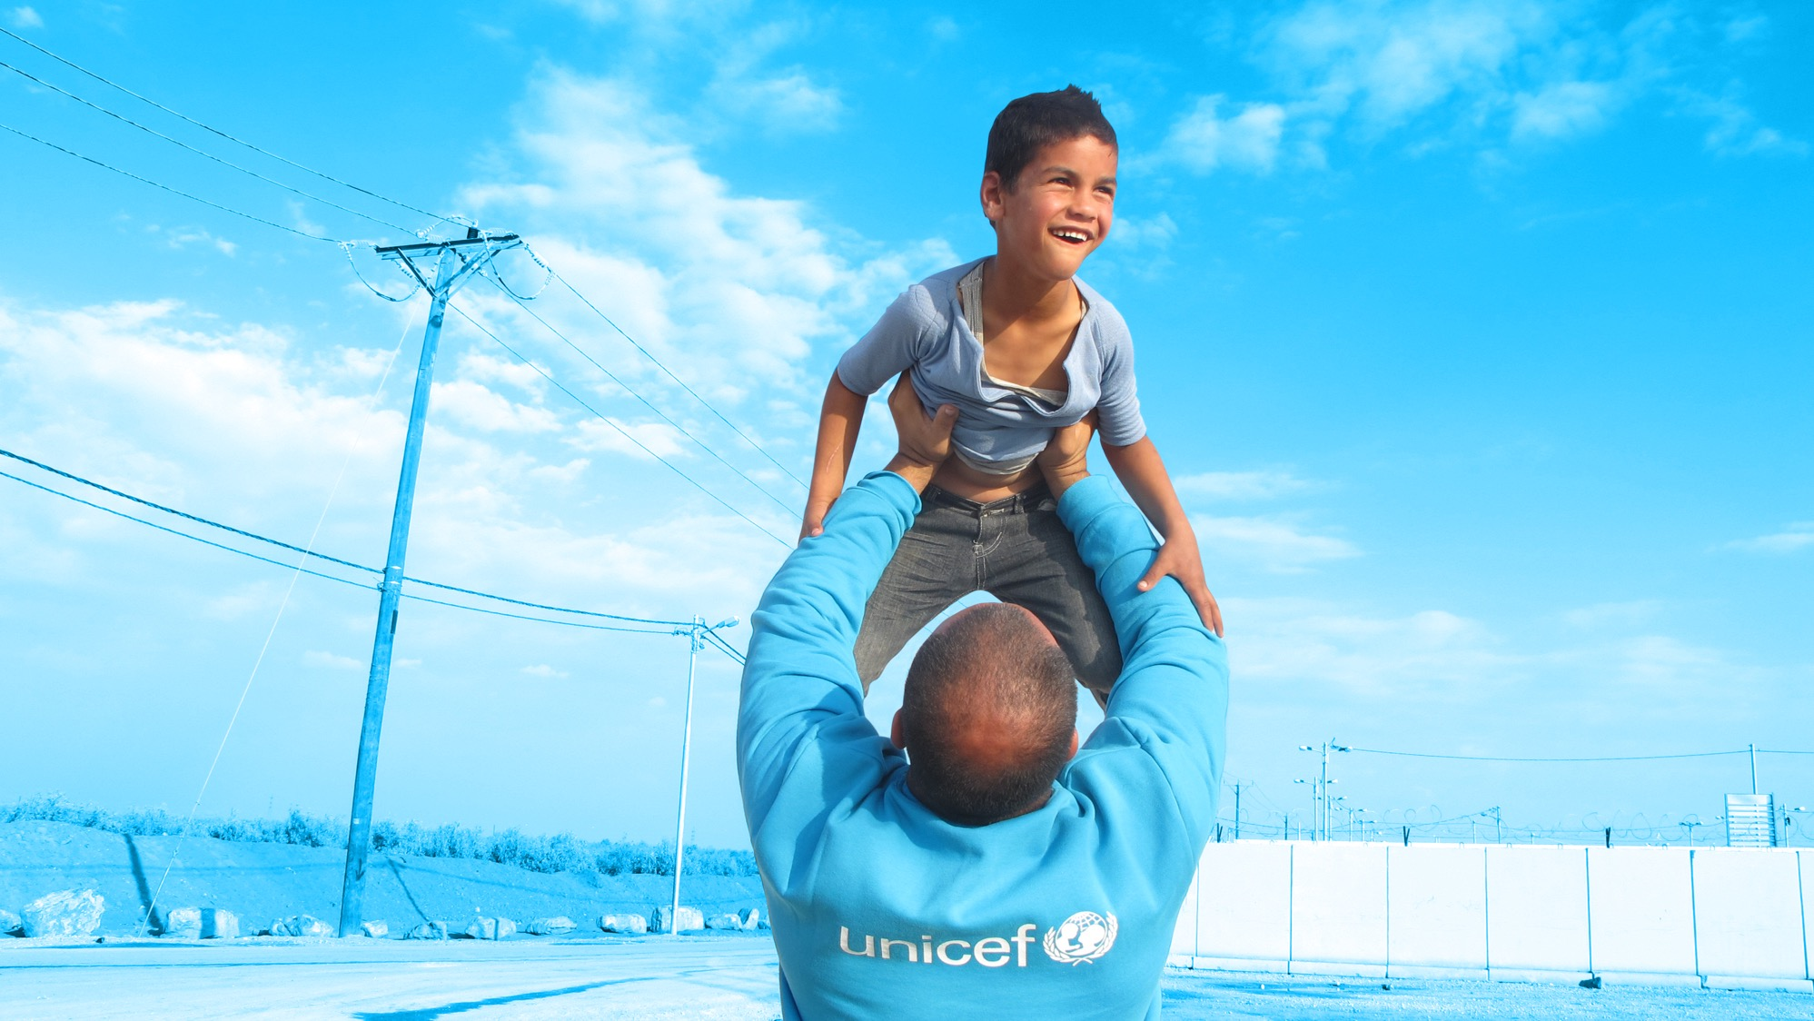
Thank you.
© UNICEF/UN0216133
27 | Community Rapid Assessment on COVID-19: Uganda

Slide 28
References
Petit, V. (2019). The Behavioural Drivers Model: A Conceptual Framework for Social and Behaviour Change Programming. UNICEF.
Croke, Kevin, et al. “Collecting High Frequency Panel Data in Africa Using Mobile Phone Interviews.” Policy Research Working Papers, 2012, doi:10.1596/1813-9450-6097
Deborah Toppenberg-Pejcic, Jane Noyes, Tomas Allen, Nyka Alexander, Marsha Vanderford & Gaya Gamhewage (2019) Emergency Risk Communication: Lessons Learned from a Rapid Review of Recent Gray Literature on Ebola, Zika, and Yellow Fever, Health Communication, 34:4, 437-455, DOI: 10.1080/10410236.2017.1405488
Durbin, Will, et al. “Chapter 3:Using Mobile Phones for High-Frequency Data Collection.” Mobile Research Methods: Opportunities and Challenges of Mobile Research Methodologies, by Daniele Toninelli et al., Ubiquity Press, 2015
Gamma, Anna E., et al. “The Impact of Various Promotional Activities on Ebola Prevention Behaviors and Psychosocial Factors Predicting Ebola Prevention Behaviors in the Gambia Evaluation of Ebola Prevention Promotions.” International Journal of Environmental Research and Public Health, vol. 16, no. 11, 2019, p. 2020., doi:10.3390/ijerph16112020
Giroux, Stacey A., et al. “A High-Frequency Mobile Phone Data Collection Approach for Research in Social-Environmental Systems: Applications in Climate Variability and Food Security in Sub-Saharan Africa.” Environmental Modelling & Software, vol. 119, 2019, pp. 57–69., doi:10.1016/j.envsoft.2019.05.011
28 | Community Rapid Assessment on COVID-19: Uganda

Slide 29
References (continued)​
Grantz, K.H., Meredith, H.R., Cummings, D.A.T. et al. The use of mobile phone data to inform analysis of COVID-19 pandemic epidemiology. Nat Commun 11, 4961 (2020). https://doi.org/10.1038/s41467-020-18190-5
Jacobsen, Kathryn H., et al. “Lessons from the Ebola Outbreak: Action Items for Emerging Infectious Disease Preparedness and Response.” EcoHealth, vol. 13, no. 1, 2016, pp. 200–212., doi:10.1007/s10393-016-1100-5
Li, Jingtao, et al. “Behaviors of High-Frequency Subscribers in Cellular Data Networks.” Security and Communication Networks, vol. 2018, 2018, pp. 1–12., doi:10.1155/2018/2506319 ​
Milusheva, Sveta. “Using Mobile Phone Data to Reduce Spread of Disease.” Policy Research Working Papers, 2020, doi:10.1596/1813-9450-9198. ​
Oliver, Nuria, et al. “Mobile Phone Data for Informing Public Health Actions across the COVID-19 Pandemic Life Cycle.” Science Advances, vol. 6, no. 23, 2020, doi:10.1126/sciadv.abc0764​
Winters, Maike, et al. “Risk Communication and Ebola-Specific Knowledge and Behavior during 2014–2015 Outbreak, Sierra Leone.” Emerging Infectious Diseases, vol. 24, no. 2, 2018, pp. 336–344., doi:10.3201/eid2402.171028
Zhang, Liwei, et al. “Effective Risk Communication for Public Health Emergency: Reflection on the COVID-19 (2019-NCoV) Outbreak in Wuhan, China.” Healthcare, vol. 8, no. 1, 2020, p. 64., doi:10.3390/healthcare8010064
29 | Community Rapid Assessment on COVID-19: Uganda

